Slide 1
Functions in Java
Dr. Ahmad Altarawneh

Slide 2
Functions and methods
Function are used to execute a block of code, do a task or perform some calculations
A function typically receives an input perform calculation and returns an output
5
SUMMATION
2
10
3

Slide 3
Cont.
Functions are usually independent and not related to an object of a class
Method typically related to class objects and often called by creating an object from the class
In java everything is wrapped in a class, so the concept of stand-alone function is not like other languages, like C++
In C++ you can have functions which does not belong to any class
In java we have a static methods, which can be called without creating an object from the class
sort of independency

Slide 4
Java methods
In java the methods have the following syntax:
access_modifier: Determines the visibility of the method. It can be one of the following: public, protected, private, or package-private (default).
static: If present, it indicates that the method is a static method and belongs to the class rather than an instance of the class.
return_type: The data type of the value the method returns. If the method does not return a value, its return type is void.
methodName: The name of the method, following standard naming conventions (camelCase).
parameter_list: A comma-separated list of input values with their respective data types. Parameters are optional; methods may not have any.
[access_modifier] [static] [return_type] methodName([parameter_list]) {
// method body
// ...
return [value]; // if return_type is not void
}

Slide 5
Example
Write a method that receives two values and prints their summation
Note here the method does not have an access modifier.
When this is the case java uses the default modifier aka package-private modifier
public class Main { static void sum(int a, int b){ int result = a + b; System.out.println(result); } public static void main(String[] args) { sum(5,20); } }
In this chapter we will keep working with static methods. Later in the OOP programming, we will revisit the access modifiers and the non static methods

Slide 6
Return types
In the previous example, the method receives two values and print their sum
What if the summed value is needed for another function?
We need to return it from the function and use it into another
All the primitives can be used as return types
Java methods can return objects of other classes as well.
public class Main { static double sum(int a, int b){ int result = a + b; return result; } static double multiply(double a, double b){ return a*b; } public static void main(String[] args) { double result = sum(10,5); double finalresult = multiply(result,2); System.out.println(finalresult); } }

Slide 7
Practice
Write a program that have two methods, as follows:
The first method takes 2 points on the cartesian coordinate system, and calculate the distance between these two points
the points are (x1,y1)(x2,y2)
The second function receives the distance from the first function and returns long distance if the distance is greater than 5 and short distance if the distance is less than or equal 5, with the distance value
$$dist= \sqrt{{\left(x2−x1\right)}^{2}+ {\left(y2−y1\right)}^{2}}$$

Slide 8
Recursion
Recursion is the process of defining something in terms of itself.
As it relates to Java programming, recursion is the attribute that allows a method to call itself.
A method that calls itself is said to be recursive.
We can use recursion instead of loops, in many applications
Some data structures implemented using recursion
Trees
Some AI searching algorithms uses recursion to find solution in the state-space
Backtracking algorithm uses recursion to solve problems

Slide 9
Recursive methods
A recursive method has a call for itself inside its body
This is an example of a recursive function that prints from 1 to n
Notice that the function is calling itself.
The recursive function must have base case, halting or termination condition.
Otherwise, it stuck in an infinite calls and results in a stack overflow error
static void show(int n) { if (n<1){ return; } show(n-1); System.out.println(n); }
Halting Condition

Slide 10
show(3) is called.
It checks if n < 1. It's false.
Calls show(2).
show(2) is called.
It checks if n < 1. It's false.
Calls show(1).
show(1) is called.
It checks if n < 1. It's false.
Calls show(0).
show(0) is called.
It checks if n < 1. It's true.
Returns without printing.
Prints 1.
Prints 2.
Prints 3.

Slide 11
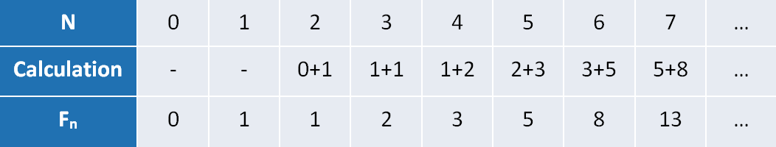
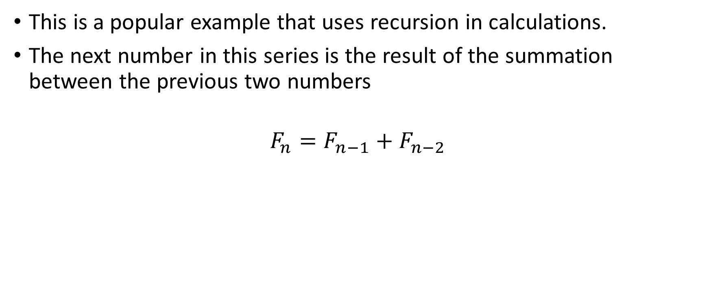
Fibonacci using recursion
This is a popular example that uses recursion in calculations.
The next number in this series is the result of the summation between the previous two numbers
$$F_{n}=F_{n−1}+F_{n−2}$$

Slide 12
public class Main { public static int fibonacci(int n) { if (n <= 1) { return n; } return fibonacci(n - 1) + fibonacci(n - 2); } public static void main(String[] args) { int n = 8; System.out.println("Fibonacci of " + n + " is: " + fibonacci(n)); } }

Slide 13
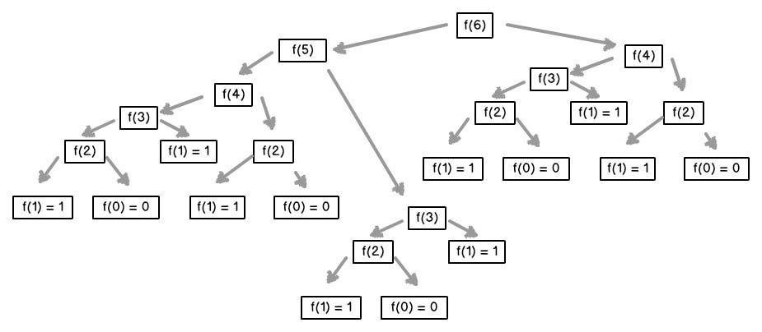
Recursion tree
public class Main { public static int fibonacci(int n) { if (n <= 1) { return n; } return fibonacci(n - 1) + fibonacci(n - 2); } public static void main(String[] args) { int n = 8; System.out.println("Fibonacci of " + n + " is: " + fibonacci(n)); } }

Slide 14
Exercise
Write a Java recursive function to find the factorial of a given number
* We will come to more complex examples in the OOP chapter

Slide 15
Pros and cons
Pros
Recursive is simpler to write than loops for tasks like tree traversal and some sorting algorithms
Helps when the problem can be divided into smaller problems making it easier to solve
cons
More memory overhead uses push and pop from the stack (slower for some tasks)
Harder to debug
Risks of stack overflow

